Slide 1
EIGRP Implementation
Troubleshooting EIGRP

Slide 2
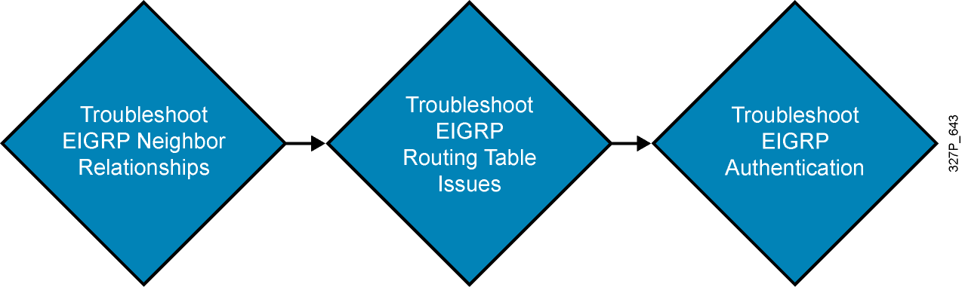
Components of Troubleshooting EIGRP

Slide 3
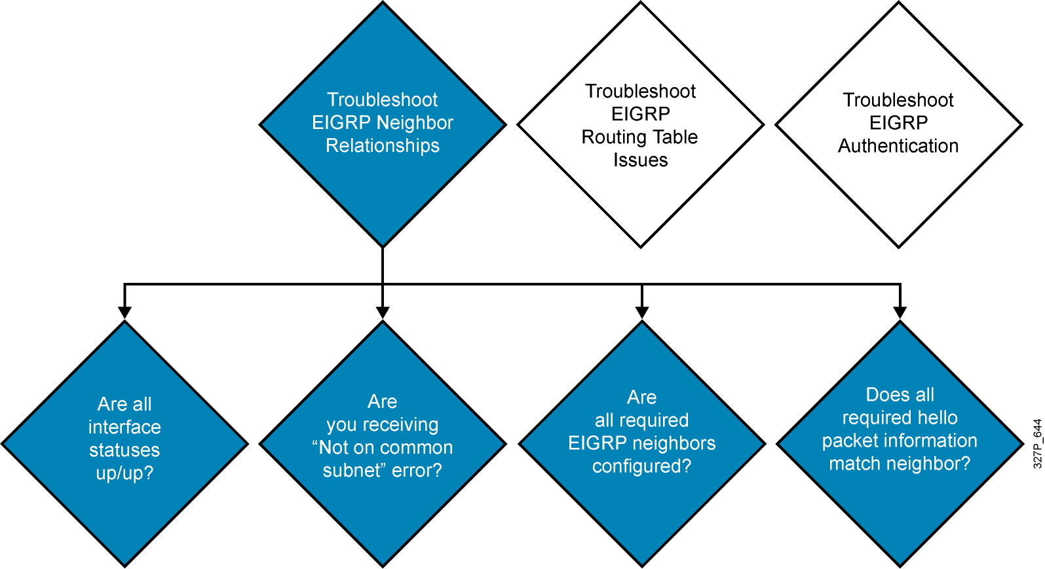
Troubleshooting EIGRP Neighbor Issues

Slide 4
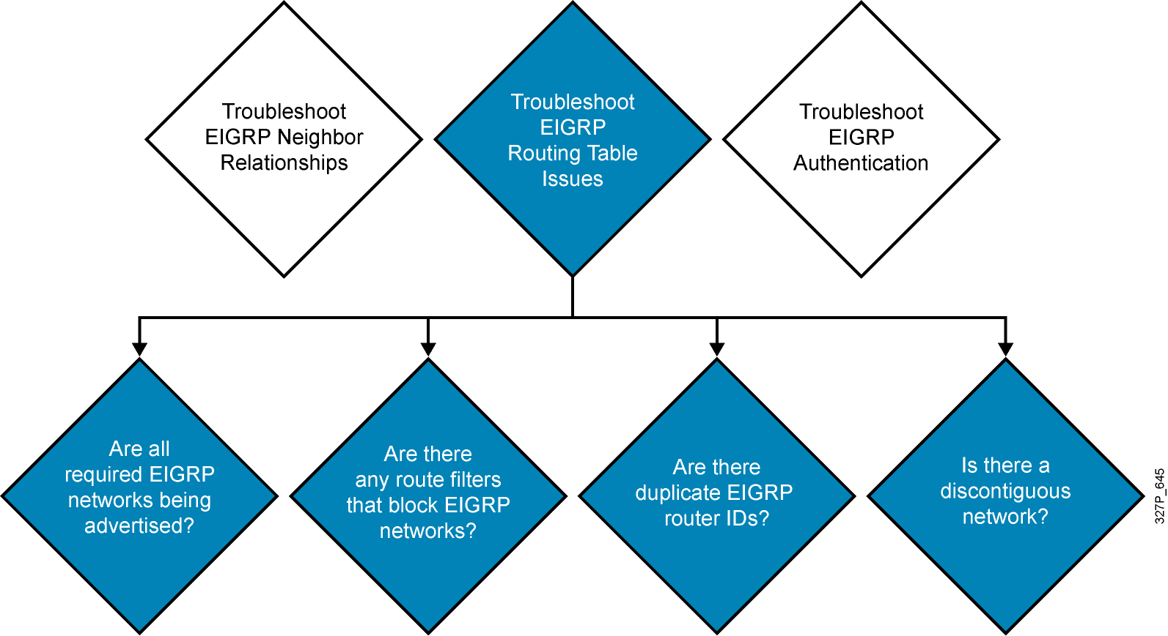
Troubleshooting EIGRP Routing Tables

Slide 5
Troubleshooting EIGRP Authentication
A successful MD5 authentication between RouterX and RouterY
RouterX# debug eigrp packets
EIGRP Packets debugging is on
(UPDATE, REQUEST, QUERY, REPLY, HELLO, IPXSAP, PROBE, ACK, STUB, SIAQUERY, SIAREPLY)
*Jan 21 16:38:51.745: EIGRP: received packet with MD5 authentication, key id = 1
*Jan 21 16:38:51.745: EIGRP: Received HELLO on Serial0/0/1 nbr 192.168.1.102
*Jan 21 16:38:51.745: AS 100, Flags 0x0, Seq 0/0 idbQ 0/0 iidbQ un/rely 0/0 pe
erQ un/rely 0/0
RouterY# debug eigrp packets
EIGRP Packets debugging is on
(UPDATE, REQUEST, QUERY, REPLY, HELLO, IPXSAP, PROBE, ACK, STUB, SIAQUERY,
SIAREPLY)
RouterY#
*Jan 21 16:38:38.321: EIGRP: received packet with MD5 authentication, key id = 2
*Jan 21 16:38:38.321: EIGRP: Received HELLO on Serial0/0/1 nbr 192.168.1.101
*Jan 21 16:38:38.321: AS 100, Flags 0x0, Seq 0/0 idbQ 0/0 iidbQ un/rely 0/0 pe
erQ un/rely 0/0

Slide 6
Troubleshooting EIGRP
Authentication Problem
Unsuccessful MD5 authentication between RouterX
and RouterY when RouterX key 2 is changed
RouterX(config-if)#key chain RouterXchain
RouterX(config-keychain)#key 2
RouterX(config-keychain-key)#key-string wrongkey
RouterY#debug eigrp packets
EIGRP Packets debugging is on
(UPDATE, REQUEST, QUERY, REPLY, HELLO, IPXSAP, PROBE, ACK, STUB, SIAQUERY, SIAREPLY)
RouterY#
*Jan 21 16:50:18.749: EIGRP: pkt key id = 2, authentication mismatch
*Jan 21 16:50:18.749: EIGRP: Serial0/0/1: ignored packet from 192.168.1.101, opc
ode = 5 (invalid authentication)
*Jan 21 16:50:18.749: EIGRP: Dropping peer, invalid authentication
*Jan 21 16:50:18.749: EIGRP: Sending HELLO on Serial0/0/1
*Jan 21 16:50:18.749: AS 100, Flags 0x0, Seq 0/0 idbQ 0/0 iidbQ un/rely 0/0
*Jan 21 16:50:18.753: %DUAL-5-NBRCHANGE: IP-EIGRP(0) 100: Neighbor 192.168.1.101
(Serial0/0/1) is down: Auth failure
RouterY#show ip eigrp neighbors
IP-EIGRP neighbors for process 100
RouterY#

Slide 7
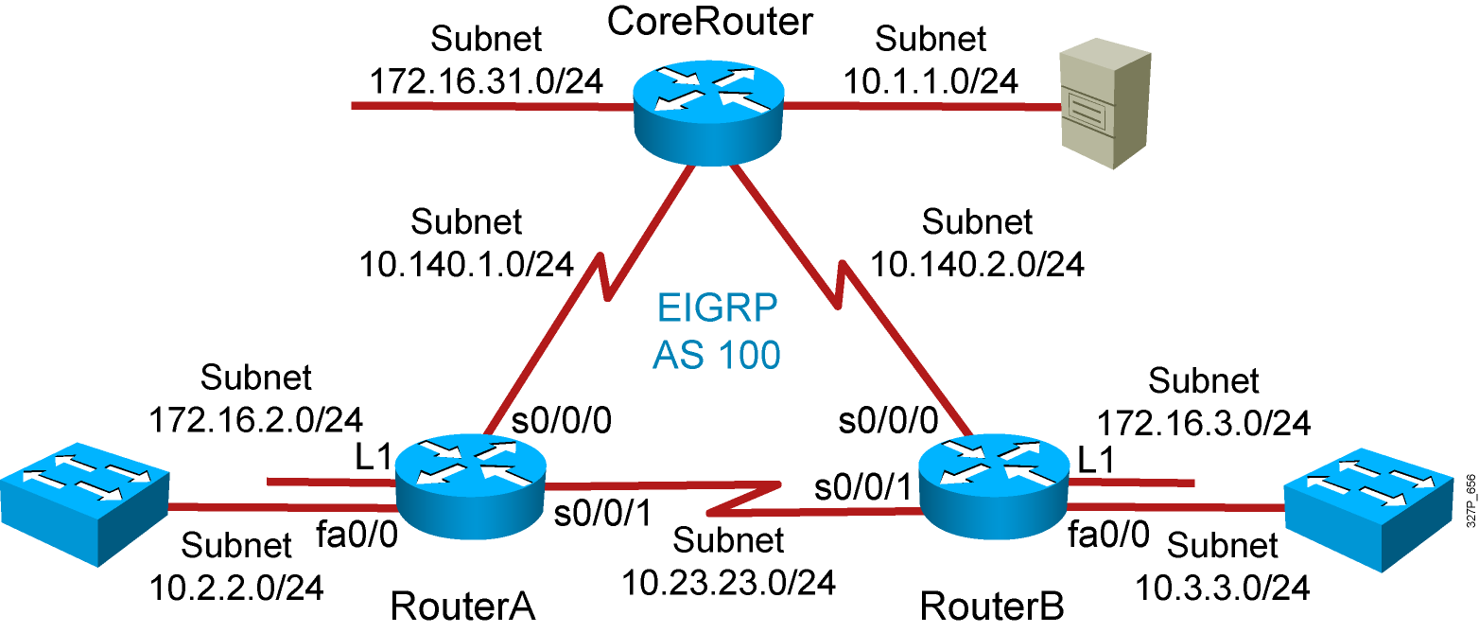
Visual Objective 5-2:
Troubleshooting EIGRP
Notes:
Lab 10 amended pod b and pod I addresses move core_ro address closer to interface same with s0 pod L
Objectives: Enable the IGRP dynamic routing protocol so your router can learn about nonconnected networks.
Purpose: Teach students how to enable IGRP.
Laboratory Instructions: Refer to the lab setup guide.

Slide 8
Summary
  There are several aspects of troubleshooting EIGRP, such as resolving neighbor relationships, routing table issues, and authentication problems.
  Issues that can cause EIGRP neighbor problems include incorrect network commands and hello packet information mismatches. Use the command show ip eigrp neighbors to help troubleshoot these issues.
  Missing EIGRP routes from the routing table may be due to route filtering or automatic summarization in discontiguous networks. Use the show ip route command to help troubleshoot these issues.
  The debug eigrp packets command can help you troubleshoot MD5 authentication problems.

